Slide 1
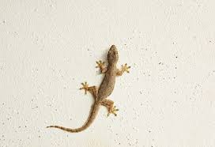
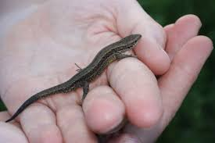
1.Wall lizards
2.Viviparous lizards

Slide 2
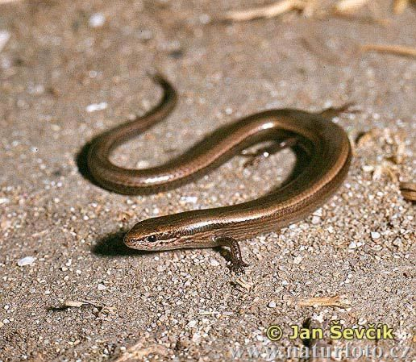
3.Snake eyed lizards

Slide 3

Why ANOVA and not t-test ???

Slide 4
ANOVA | T-test
Examines whether group mean differs from one another
More than two groups used when there is just two groups
Error can be reduced multiple t-test increases chance of error
Single step solution multiple t-tests have to be conducted

Slide 5
ASSUMPTIONS
All samples are independent
Dependent variable is continuous
Its normally distribute
Homogeneity of variance

Slide 6
$ symbol
The $ operator uses a name to perform the extraction as in an Object$aName. Therefore it enables one to extract items from a list based on their names
attach()
The database is attached to the R search path. This means that the database is searched by R when evaluating a variable, so objects in the database can be accessed by simply giving their names
as.factor()
as.factor. Converting a vector into a factor.

Slide 7
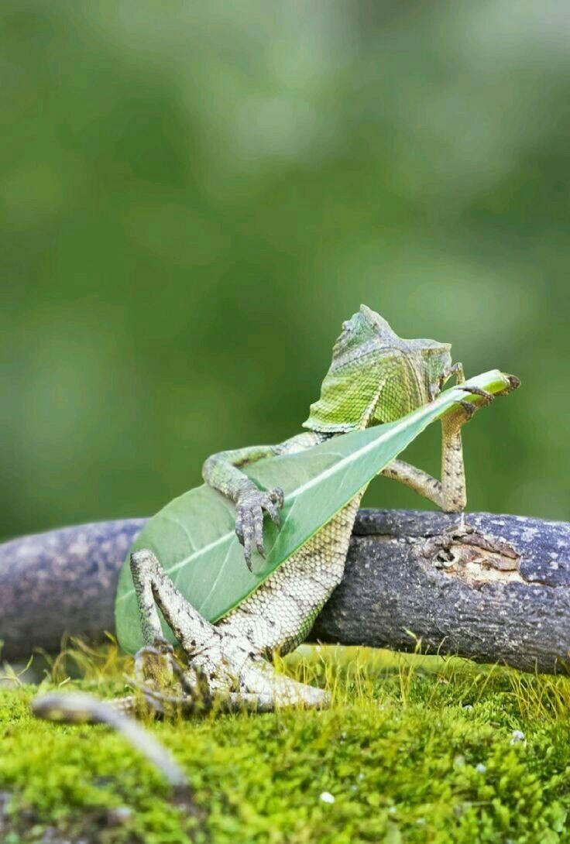
Conclusion
Snake eyed lizard and wall lizards have similar
size
Viviparous lizards have significant difference
in size when compared to snake eyed and wall
lizard

Slide 8
SUMMARY
Check if they are of normal distribution
Label and set categorical factors
Load the data
Test for homogeneity
(Bartlett test)
Post – hoc test
(tukey test )
Anova test

Slide 9


